Slide 1


A NEW VOTING PLATFORM
CONDUCTING FREE AND FAIR ELECTIONS
Student Name :
Devansh Vashistha
Student ID :
College Name :
STU61f03179ee0761643131257
KIET Group of Institutions, Ghaziabad

Slide 2
CAPSTONE PROJECT SHOWCASE
Project Title
E-VOTING
Abstract | Problem Statement | Project Overview | Proposed Solution | Technology Used | Modelling & Results | Conclusion | Q&A

Slide 3
Abstract
1
User-Friendly Interface: To improve the voting experience for all participants, our E-Voting platform has an easy-to-use interface. Voters can conveniently and seamlessly participate in the electoral process by simply accessing the platform from any device with an internet connection.
2
Real-Time Results: As soon as they vote, users can view real-time voting results using our Django-based E-Voting platform. The platform uses effective data processing methods to quickly tabulate and display precise voting results, giving interested parties timely information about the state of the election.
3
Accessibility and Inclusivity: We make sure that our E-Voting platform conforms with web accessibility standards to prioritize accessibility and inclusivity. Everyone can exercise their right to vote in an independent and efficient manner thanks to the platform's ability to accommodate users with varying needs and abilities.

Slide 4


Problem Statement
There are a number of issues with the traditional voting process, including its limited accessibility, the laborious manual counting process, and the possibility of vote tallying errors. We require a cutting-edge, safe, and effective online voting system to solve these problems. Using Django, a high-level Python web framework, the project intends to create an online voting platform that will enable safe, practical, and transparent voting procedures for a range of elections and surveys.

Slide 5

Project Overview
The project entails utilizing the well-liked Python web framework Django to create an online voting system. Voter registration, authentication, and involvement in a variety of elections and surveys will all be made possible by the platform. The creation of ballots, tracking results in real time, strong security features, improvements to accessibility, and an easy-to-use admin dashboard for effective management are some of the key features. Through the use of Django's features, this project aims to guarantee the integrity and transparency of electoral activities in the digital age, revolutionize voting, and encourage democratic participation.

Slide 6
Proposed Solution
Develop a web-based voting platform using Django, a high-level Python web framework.
Implement user registration and authentication functionality for secure voter participation.
Enable administrators to create and customize electronic ballots for various elections, referendums, or surveys.
Design a user-friendly interface for voters to cast their votes securely and anonymously.
Display real-time voting results and statistics to enhance transparency and engagement.
Ensure the platform is accessible to all users, including those with disabilities, by following web accessibility standards.

Slide 7
Technology used
Django Framework: The projects are built using the Django web framework, a high-level Python web framework that encourages rapid development and clean, pragmatic design.
Python Programming Language: Python is the primary programming language used in these projects for backend development.
HTML, CSS, JavaScript: Knowledge of front-end technologies like HTML, CSS, and JavaScript is essential for developing user interfaces and interactive elements.
SQLite Database: The projects often use SQLite, a lightweight relational database management system, for data storage.
Visual Studio Code: A code editor like Visual Studio Code is recommended for working on the projects.
Web Accessibility Standards: Projects aim to adhere to web accessibility standards to ensure the platform is accessible to all users, including those with disabilities.

Slide 8
Modelling & Result

Slide 9
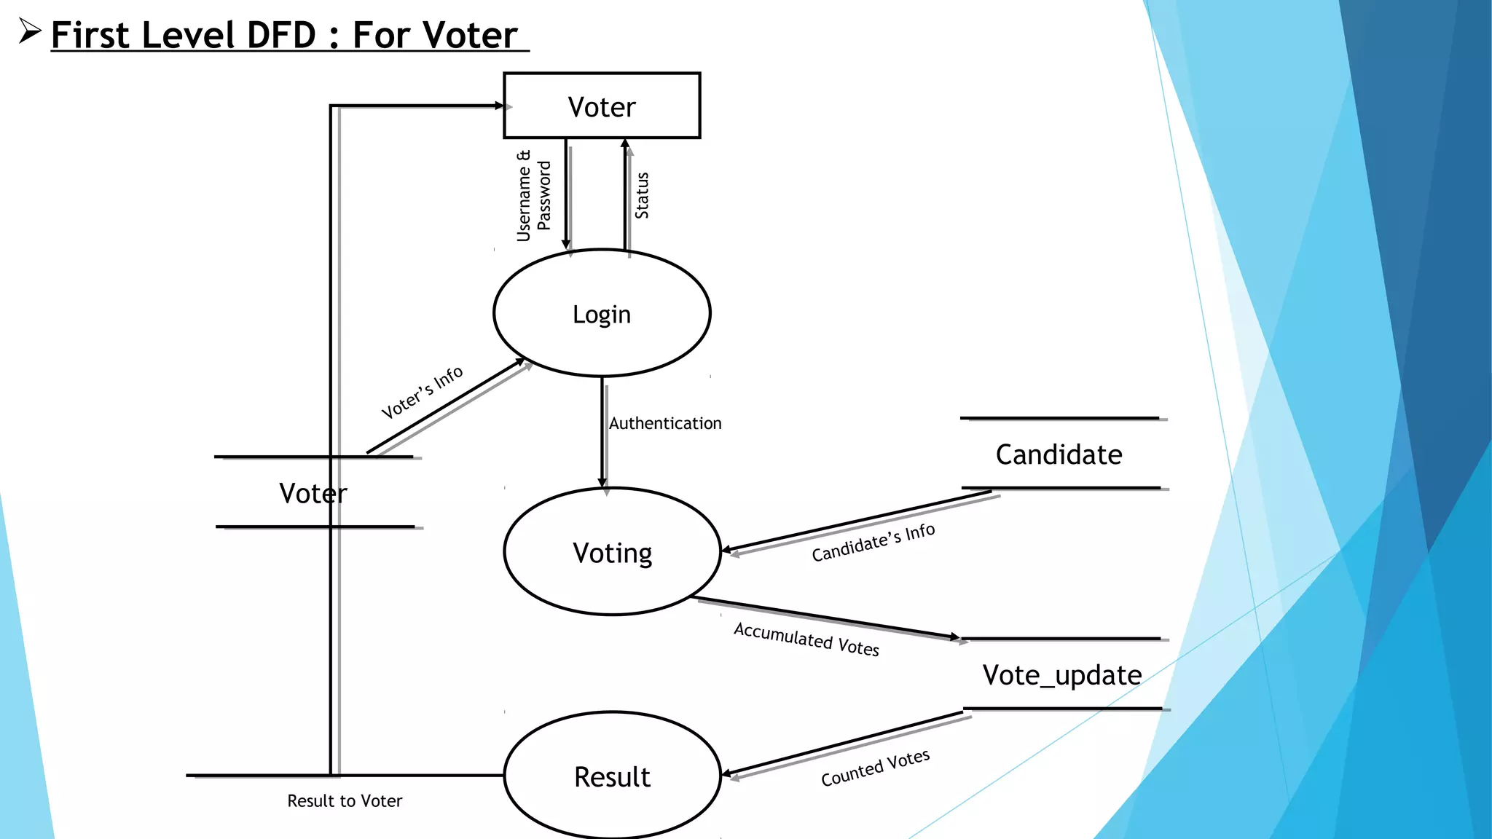
Modelling & Result

Slide 10
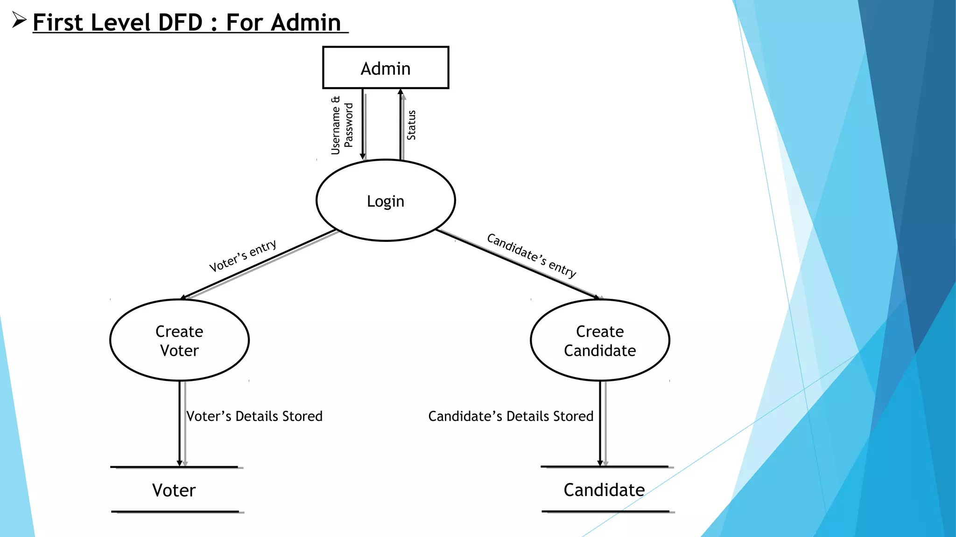
Modelling & Result

Slide 11

Conclusion
In conclusion, the Django-developed eVoting system provides a cutting-edge and effective platform for holding elections online. The election process is kept secret while maintaining transparency and accountability thanks to the system's user authentication, candidate registration, and streamlined election management features. Accessibility and system trust are improved by timely results publication, real-time updates on election progress, and candidate profiles. The e-Voting system advances democratic processes and improves civic engagement in the modern era by promoting stakeholder communication and upholding best practices in election administration.

Slide 12


Notes:
Thank You !!

